Slide 1


Slide 2
Data models, Schemas, and Instances
Data model:-A set of concepts to describe the structure of a database, and certain constraints that the database should obey.
Schema:- The overall description of the database is called the Database Schema.
  A schema is defined as an outline or a plan that describes the records and relationships existing at the particular level.
  Instance:- Data in the database at a particular moment in time.

Slide 3
Data abstraction
A major purpose of database system is to provide user with an abstract view of data. That is, system hides certain details of how the data are stored and maintained.

Slide 4
Levels of Abstraction(view of data)
Physical/Internal level: this level describes how data is stored in database.
Logical/Conceptual level: describes what data is stored in database, and the relationships among the data.
View/External level: This level describes that part of the database that is relevant to each user.

Slide 5

View of Data
An architecture for a database system

Slide 6
Database Languages
Database languages are used to create and maintain database on computer.
Data Definition Language(DDL): It is a language that allows user to define data and their relationship to other types of data.
  CREATE
  ALTER
  DROP
  RENAME
Data Manipulation Language(DML):It provides a set of operations to support the basic data manipulation operations on the data held in databases. It allows user to insert, update, delete and retrieve data from the database.
  DELETE
  INSERT
  SELECT
  UPDATE

Slide 7
Database Languages
Data Control Language(DCL): DCL statements control access to data and the database
  GRANT
  REVOKE
  COMMIT
Transaction Control Language(TCL): TCL statements manage the change made by DML statements, and group DML statements into transactions
  COMMIT
  ROLLBACK
  SAVEPOINT

Slide 8
Database Architecture

Slide 9

Three-tier architecture

Slide 10
Advantages of Three-Tier Architecture
Scalability
Data Integrity
Data Security
Balancing of Load is much easier with division of core business from the server of the database
High performance
Network utilization is minimized, therefore load is reduced

Slide 11
Disadvantages
More complex than 2-tier Client Server Architecture
Maintenance

Slide 12
External or View level: It is the user’s view of the database. This level describes that part of the database that is relevant to each user.
  For example, one user may view dates in the form (day, month, year), while another may view dates as (year, month, day).
Conceptual or logical level: It is the community view of the database. This level describes what data is stored in the database and the relationships among the data.
It represents:
  All entities, their attributes, and their relationships;
  The constraints on the data;
  Security and integrity information.
Internal or storage level: It is the physical representation of the database on the computer. This level describes how the data is stored in the database.

Slide 13
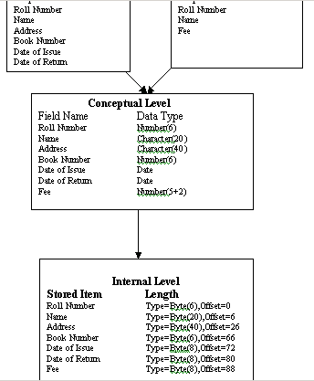

Slide 14
Data Independence
Data independence can be explained using the three-schema architecture.
Data independence refers characteristic of being able to modify the schema at one level of the database system without altering the schema at the next higher level.

Slide 15
Data Independence-Achievement of Layered Architecture of DBMS
Two kinds of data independence:
  Logical data independence
  Physical data independence

Slide 16
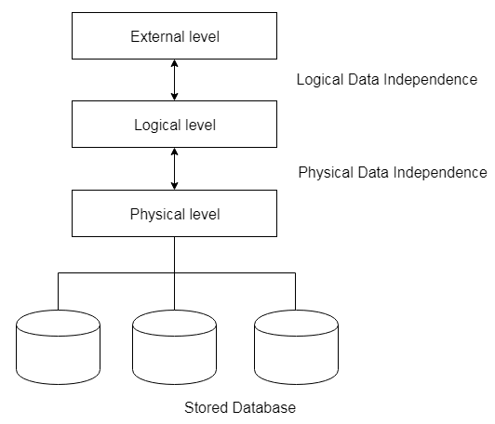


Slide 17
Logical Data Independence
The capacity to change the conceptual schema without having to change the external schemas and their application programs.
Logical data independence is used to separate the external level from the conceptual view.
If we do any changes in the conceptual view of the data, then the user view of the data would not be affected.
Logical data independence occurs at the user interface level.

Slide 18
Physical Data Independence
The capacity to change the internal schema without having to change the conceptual schema.
If we do any changes in the storage size of the database system server, then the Conceptual structure of the database will not be affected.
Physical data independence is used to separate conceptual levels from the internal levels.
Physical data independence occurs at the logical interface level.

Slide 19
Contd…
The processes of transforming requests and results between the levels are called mappings.
When a schema at a lower level is changed, only the mappings between this schema and higher-level schemas need to be changed in a DBMS that fully supports data independence. The higher-level schemas themselves are unchanged. Hence, the application programs need not be changed since they refer to the external schemas.

